Slide 1
Data-Driven AI Modelling of Emerging FETs: MLP Deep Learning Approach
Presenters:
Hammad Omar The American University in Cairo
Lin Zhuofan Universiti Putra Malaysia
Lin Zhuofan

Slide 2
Table of Content
Introduction
Data Analysis and Preprocessing
Proposed Approach and Results
Challenges and limitations
Future Work

Slide 3
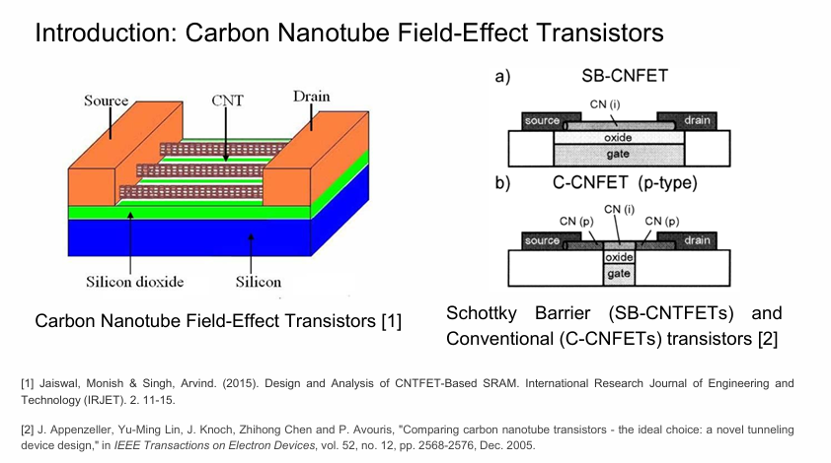

Slide 4
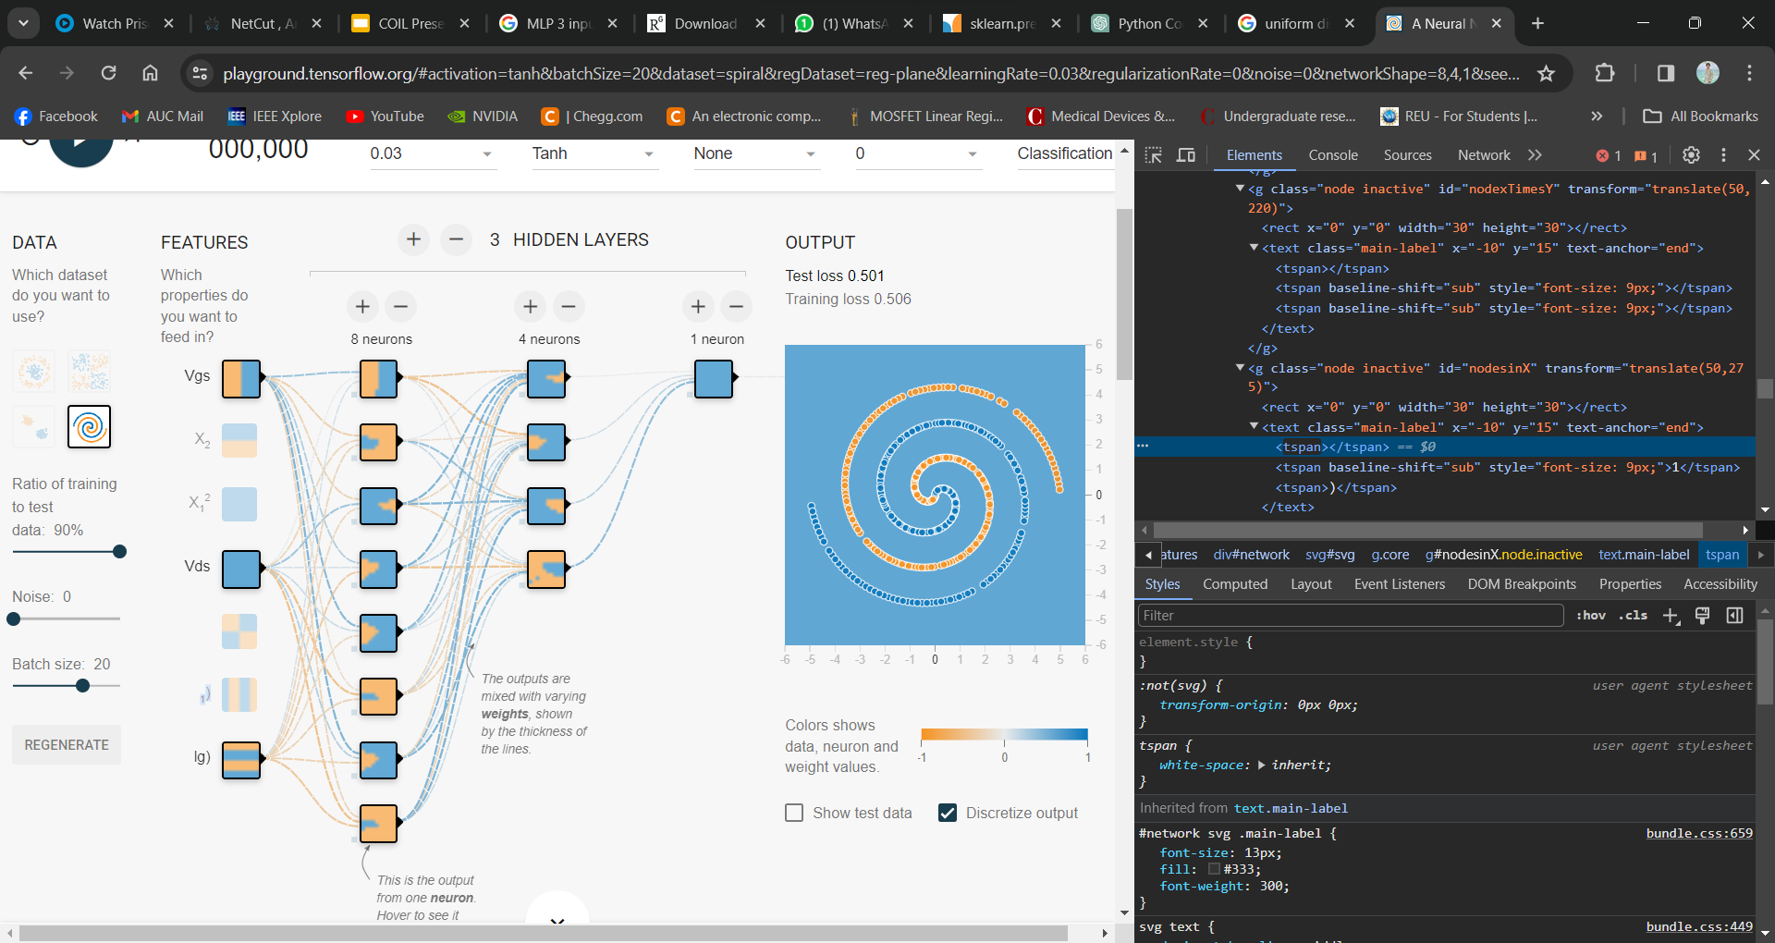
Introduction-2
Multilayer-Perceptron
Ids
*Simulation for a multi-hidden layer, 3-hidden layers, 3 inputs, and 1 output

Slide 5
Normalization: Quantile Transformation
Methodology:
01
Ranks the values in the original dataset of P-FET. Each value is assigned a rank based on its position in the sorted order of the dataset.
The quantiles are computed for each data point based on its rank. Quantiles represent the proportion of data below a certain value
02
Specifies that the transformed data should have a normal (Gaussian) distribution. The mapping of quantiles results in transformed values that follow the specified distribution, a normal distribution.
03

Slide 6
Quantile Transformation VS Conventional Scaling
Min-Max Scaling (MinMaxScaler)
Quantile transformer
Considerations:
Sensitive to outliers, as the entire range is influenced by extreme values.
May not be suitable for data with non-Gaussian distributions.
Potential Benefits:
Quantile Transformation is a non-parametric method that does not assume a specific distribution.
Normalization of Skewed Distributions: If data has a skewed distribution, Quantile Transformer can help normalize it, which might be beneficial for the ANNs.
Robustness to Outliers:
Quantile-based transformations are less sensitive to outliers compared to other scaling techniques.
Improved Model Performance:
Normalizing the data can contribute to better convergence during training.
Standardization (StandardScaler)
Considerations:
Does not ensure a specific range for the scaled data.
May not be optimal for non-Gaussian distributions.

Slide 7
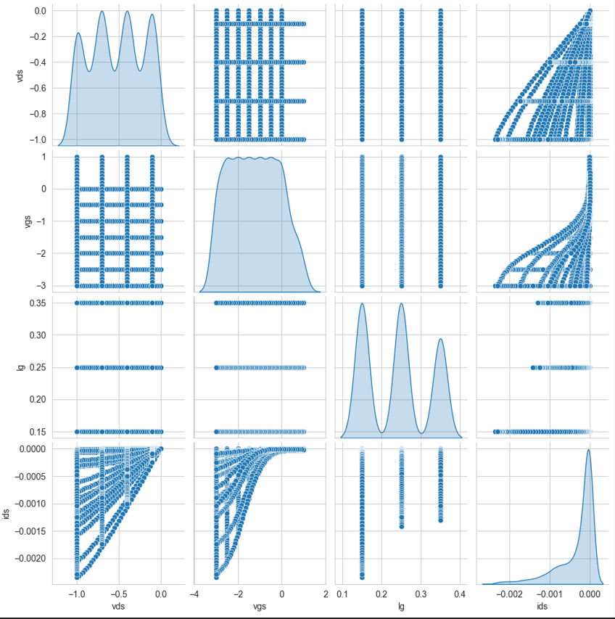
Original dataset pairplot

Slide 8
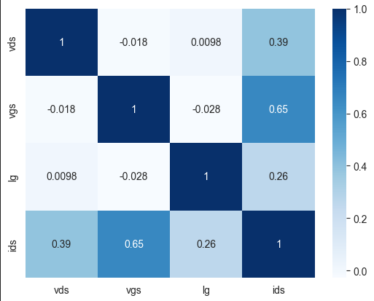
Correlation Matrix

Slide 9
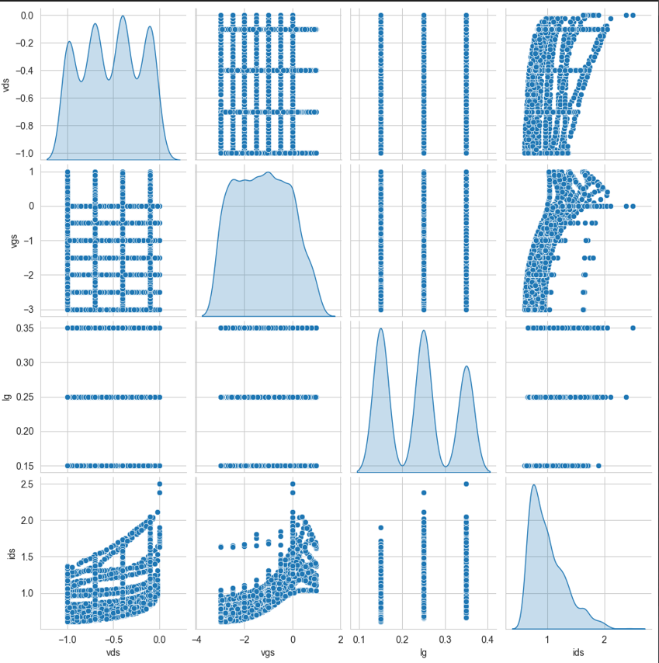
Before ids normalization
(Scaling and Quantile transform)
Training Dataset

Slide 10
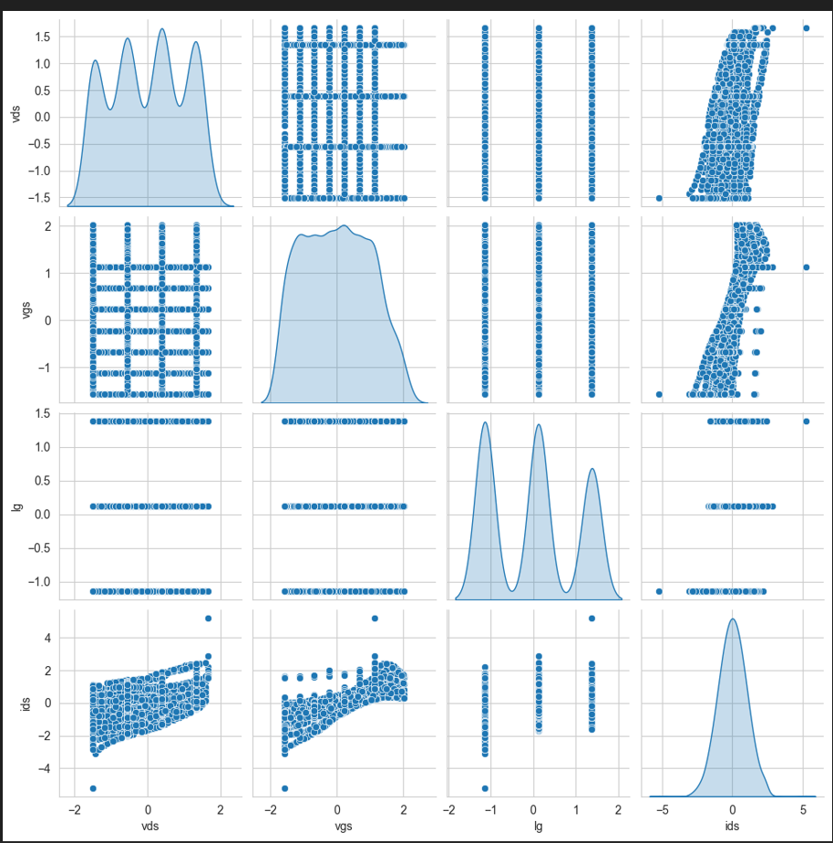
After ids normalization
Training Dataset

Slide 11
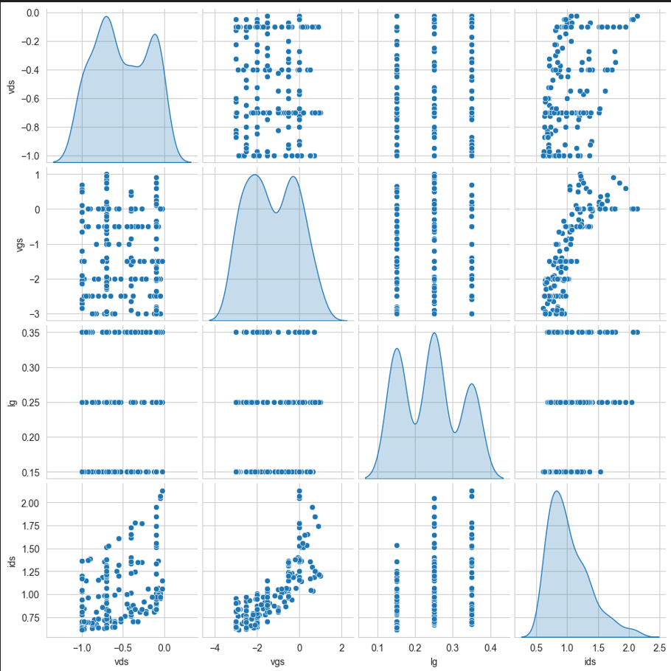
Before Pre-Processing
Validation Dataset

Slide 12
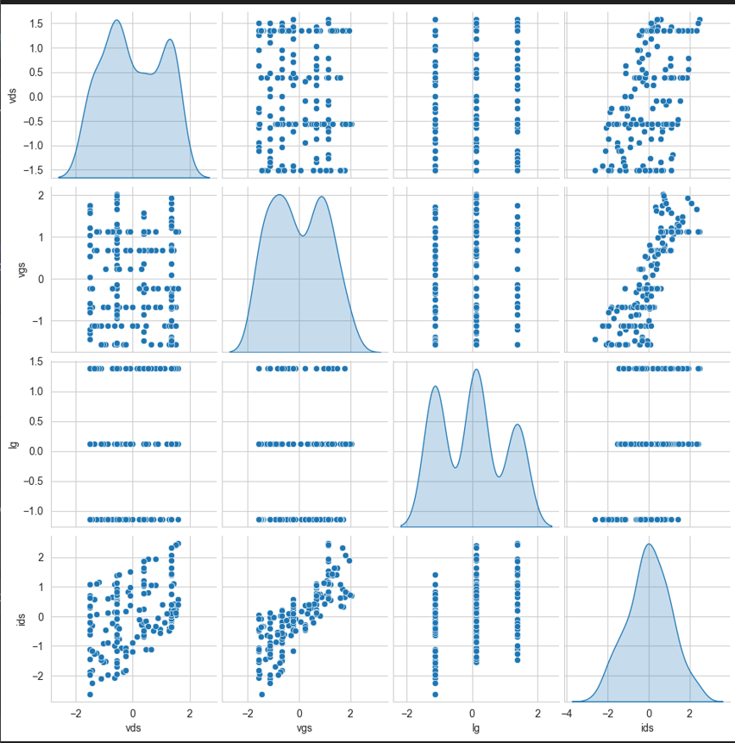
After Pre-Processing
Validation Dataset

Slide 13







Customize Weighted Loss Function
Ids
Where the Weights can be defined by the inputs.
The Weights function defined in this project was:
Notes:
Thanks Omar for introducing the MLP structure and preprocessing technique in our project. Next, Im gonna discuss the Loss function we implemented in this project. This can be called as customize weighted loss function since we introduced weights according to the different vds, vgs and lg parameters.

Slide 14
Training and Validation Flow
Ids
Pseudo Code
load dataset;
k-fold splition with 9:1 for training and validation dataset;
for i in k-fold:
exponential scaling;
normalization;
for loss_function in [customized_loss_function, MAE, RMSE]:
train the model with early stopping;
predict the values of whole dataset;
calculate r2_score, MAE for the outputs;
save the weights of the models;
Notes:
Thanks Omar for introducing the MLP structure and preprocessing technique in our project. Next, Im gonna discuss the Loss function we implemented in this project. This can be called as customize weighted loss function since we introduced weights according to the different vds, vgs and lg parameters.

Slide 15
Comparisons with K-Fold Validation
The customize loss function include the inputs into consideration to refine the direction of learning process. By using 5-fold training, it showed some improvement compared to the traditional loss function with the same preprocessing and MLP structure.
Ids
LOSS FUNC | 1 |  | 2 |  | 3 |  | 4 |  | 5 |  | AVG
 | R2 | MAE | R2 | MAE | R2 | MAE | R2 | MAE | R2 | MAE | R2 | MAE
CUSTOMIZE | 0.9963 | 1.40E-05 | 0.9962 | 1.39E-05 | 0.9952 | 1.43E-05 | 0.9971 | 1.16E-05 | 0.9968 | 1.33E-05 | 0.9963 | 1.34E-05
MAE | 0.9941 | 2.14E-05 | 0.9956 | 1.50E-05 | 0.9961 | 1.60E-05 | 0.9962 | 1.41E-05 | 0.9976 | 1.02E-05 | 0.9959 | 1.54E-05
RMSE | 0.9927 | 2.11E-05 | 0.9956 | 1.71E-05 | 0.9947 | 1.73E-05 | 0.9963 | 1.48E-05 | 0.9969 | 1.28E-05 | 0.9953 | 1.66E-05
Overfitting in Plots
Notes:
Thanks Omar for introducing the MLP structure and preprocessing technique in our project. Next, Im gonna discuss the Loss function we implemented in this project. This can be called as customize weighted loss function since we introduced weights according to the different vds, vgs and lg parameters.

Slide 16
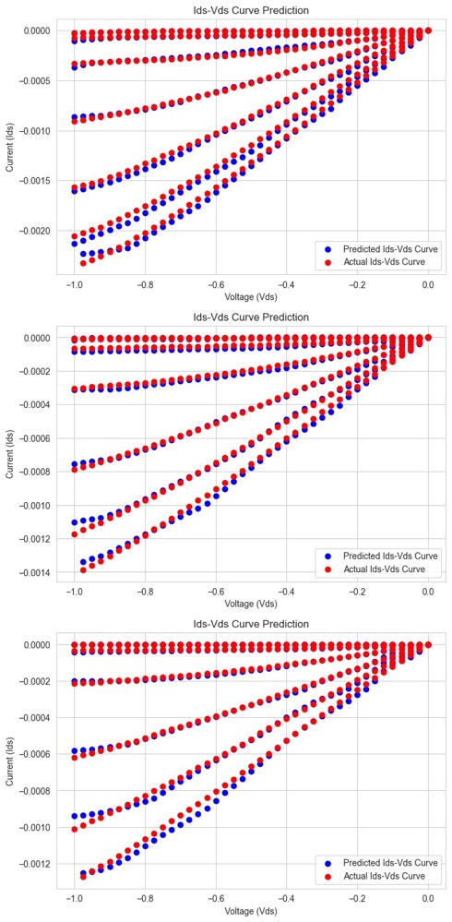
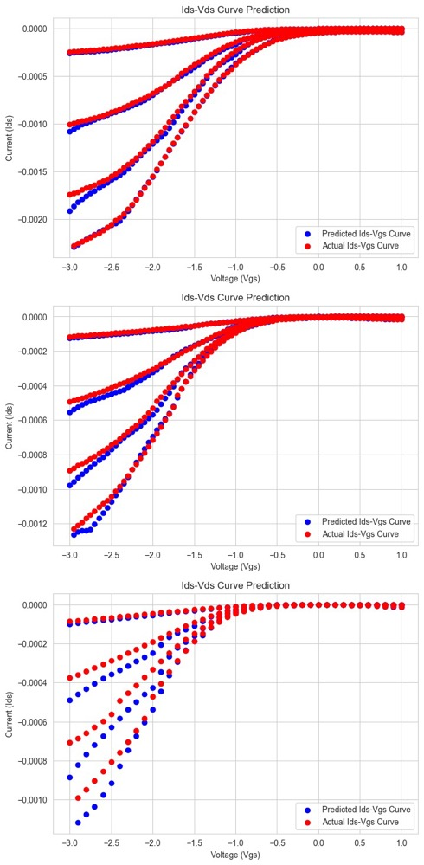
Results
Ids vs Vds Curve
- The slope had a better fitting
- Still had some error in low Vds domain
Ids vs Vgs Curve
- The slope had a better fitting
- Still had some error in low Vgs domain
- There was underfitting problem in k=0.35 due to less samples
Ids
Notes:
Thanks Omar for introducing the MLP structure and preprocessing technique in our project. Next, Im gonna discuss the Loss function we implemented in this project. This can be called as customize weighted loss function since we introduced weights according to the different vds, vgs and lg parameters.

Slide 17
Challenges and Future Work
Original Dataset
Expected Dataset
Data Augmentation

Slide 18
Thank you!

